Slide 1


Slide 2

Title:-AUTOMATION IN GREENHOUSE
Submitted to: Dr. Sabah Mohammed
Project By: Ganesh Kumar Dhanapalan (0748792)

Slide 3
INTRODUCTION
Over consumption of resources in Agricultural
Microcontroller ATmega328P is used in the field of agriculture to equipment various plant parameters
The use of Arduino UNO and sensors eases the work of a farmer
They fulfill the duties of automatic water irrigation using soil moisture sensor, determining the necessary pH content, light intensity, humidity, and temperature of the air and soil

Slide 4
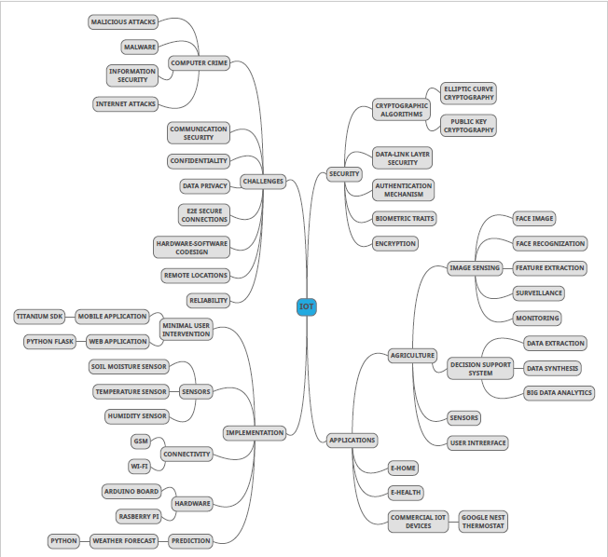
MIND MAP OF KEYWORDS

Slide 5
LITERATURE SURVEY
The papers referred for this project has been categorized into 4 groups based upon their insight
GROUP | INSIGHT | PROS | CONS
GROUP 1 | Architecture | Theoretical knowledge Layer wise approach Need for the least energy consumption of the iot devices | Not all the layers are required for developing the application It doesn’t provide the efficiency difference between three layer and four layer approach

Slide 6
LITERATURE SURVEY
GROUP 2 | Effects of IoT on agriculture | The monitoring of the soil conditions for maintaining the plant growth The determination of the amount of water required for the plant based upon its condition | Not all the factors that are needed for the plant growth has been considered
GROUP 3 | Advancements | The use of cloud for storing the sensor data. The use of MQTT protocol for the M2M communication | Not all the features have been implemented on a single application All the papers discuss either about the manual or about the automation of the agricultural process but not both

Slide 7
LITERATURE SURVEY
GROUP 4 | Real time implementation examples | The use of the temperature, humidity, PH, and light intensity for monitoring the plant growth The use of NODEMCU 8266 as the Wi-Fi module The use of threshold value for determining and maintaining the favorable conditions for the automatic plant monitoring and growth | None of the papers gives emphasis about the cloud computing, data storage and analysis All the models are complicated and expensive to maintain

Slide 8
PROBLEM STATEMENT
The proposed system is a Hybrid System in which the following recommendations of other projects/systems are taken into account and considered for developing a better indoor plant garden
The use of the temperature, humidity, PH, light intensity and soil moisture for monitoring the plant growth
The use of NODEMCU 8266 as the Wi-Fi module
The use of threshold value for determining and maintaining the favorable conditions for the automatic plant monitoring and growth
The use of cloud for storing the sensor data
The use of MQTT protocol for the M2M communication

Slide 9
HYPOTHESIS
HYPOTHESIS 1: The healthy plant growth can only be achieved if the plants are monitored and fertilized at proper intervals.
HYPOTHESIS 2: The remote communication and the automation of events can create a huge impact in the indoor plant growth.
HYPOTHESIS 3: The creation of plant dataset may provide valuable knowledge about the indoor plant growth.

Slide 10
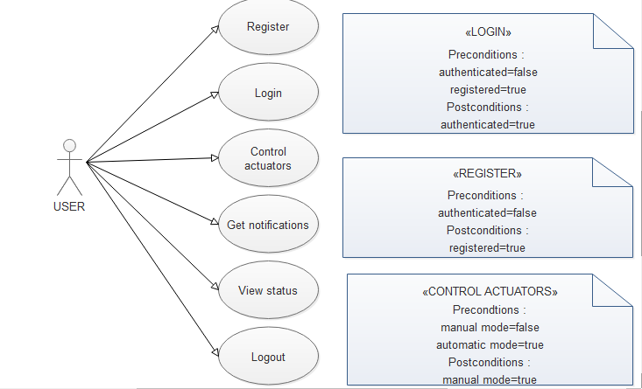
METHODOLOGY

Slide 11
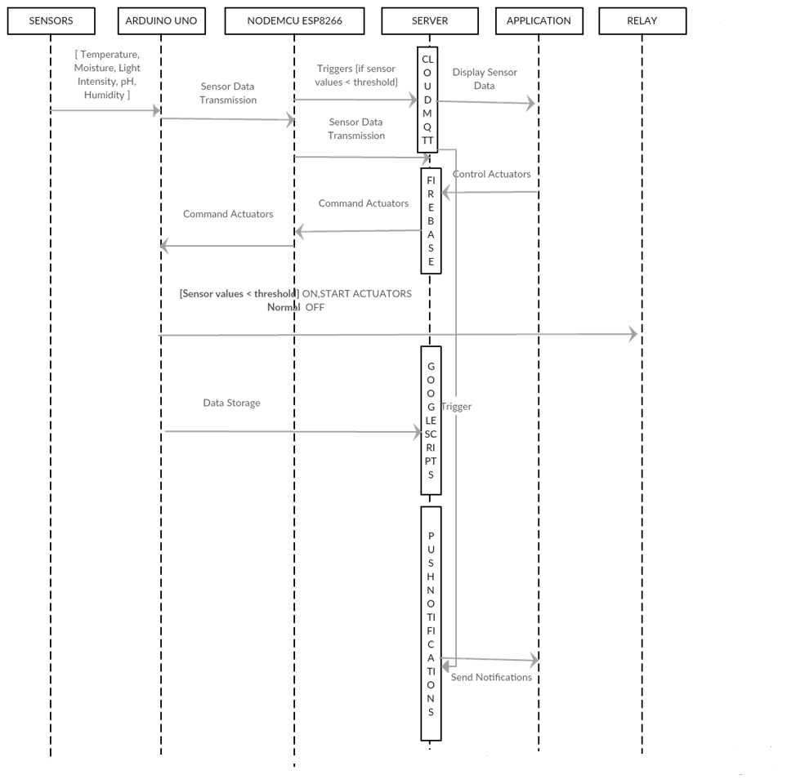
METHODOLOGY

Slide 12
HARDWARE AND SOFTWARE REQUIREMENTS
HARDWARE REQUIREMENTS:
Arduino Uno
Node MCU 8266
DC 5V Relay
Pump 5V
DS18B20
SOIL MOISTURE
DHT 22
Resistor 4.7 K ohm
PH Sensor
Full Spectrum A19 LED Grow
LDR
Jumper Cable
Ultrasonic mist generator

Slide 13
HARDWARE AND SOFTWARE REQUIREMENTS
SOFTWARE REQUIREMENTS:
Arduino
Android Studio

Slide 14
SYSTEM DESIGN
The 3-layered architectural framework in IOT
Data Collection
Data Transfer
Data Storage
Data Collection : collecting the data from the sensors
Data Transfer :
Arduino Uno to NodeMCU ESP8266
NodeMCU ESP8266 to Cloud
Cloud to Application services
Data Storage :
Google Sheets
SD Card

Slide 15
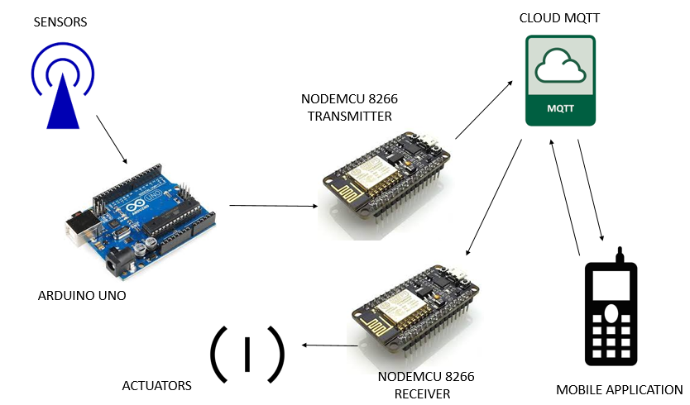
BLOCK DIAGRAM

Slide 16
BLOCK DIAGRAM
The main blocks of this project are:
NodeMCU 8266
Arduino Uno
Sensors
Actuators
Cloud Services
Mobile application

Slide 17
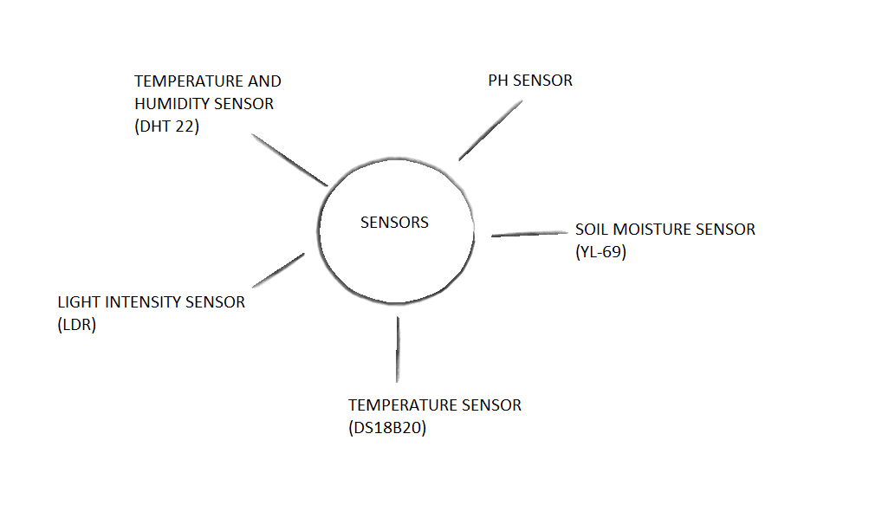
SENSORS

Slide 18
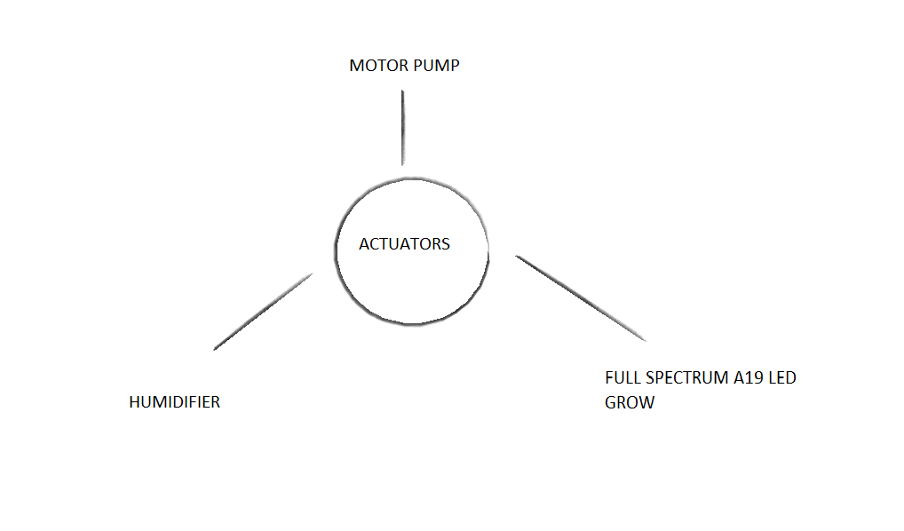
ACTUATORS

Slide 19
OUTPUT
Sensor Values (Break points):
Sensor value = 255:
Soil Moisture = 255 {Reason: COMMUNICATION ISSUE BETWEEN NODEMCU AND MQTT}
Temperature (Air) = 255 {Reason: COMMUNICATION ISSUE BETWEEN NODEMCU AND MQTT}
Temperature (Soil) = 255 {Reason: COMMUNICATION ISSUE BETWEEN NODEMCU AND MQTT}
Humidity = 255 {Reason: COMMUNICATION ISSUE BETWEEN NODEMCU AND MQTT}
PH Value = 255 {Reason: COMMUNICATION ISSUE BETWEEN NODEMCU AND MQTT}
Light Intensity = 255 {Reason: COMMUNICATION ISSUE BETWEEN NODEMCU AND MQTT}

Slide 20
OUTPUT
Sensor value > Threshold:
Soil Moisture = 70 {Action: Pump is switched OFF}
Humidity = 40 {Action: Humidifier is switched OFF}
Light Intensity = 55 {Action: Light is switched OFF}
Sensor value < Threshold:
Soil Moisture = 49 {Action: Pump is switched ON}
Humidity = 29 {Action: Humidifier is switched ON}
Light Intensity = 39 {Action: Light is switched ON}
Sensor value = Threshold:
Soil Moisture = 50 {Action: Pump is switched OFF}
Humidity = 30 {Action: Humidifier is switched OFF}
Light Intensity = 40 {Action: Light is switched OFF}

Slide 21
CONCLUSION
The development of this project is inexpensive and provide very superior performance for the diverse task
The system is very useful since it is difficult to find the farm hand for assisting in lot of countries
It is very effective and efficient model for monitoring the life of a plant from remote location without any difficulty

Slide 22
BENEFITS
Inexpensive and easy to install.
The use of google sheet for storing the sensor data.
The use of MQTT protocol for faster M2M communication.
All the necessary sensors needed for monitoring the plant growth has been used.
Simple user interface for the android application.
Secured model

Slide 23
DRAWBACKS
Difficult to maintain the model.
Difficult to identify the error.
Sensors are not reliable since they are inexpensive.
Frequent communication error can occur due to poor or no internet connection.
The entire model is completely dependent on the internet connection.

Slide 24
FUTURE WORK
The use of camera module can provide the real-time surveillance of the plant
The use of image analysis for predicting the disease
The data can be analyzed for predicting the timely behavior of the actuator
The incorporation of machine learning enhances the efficient way to monitor the growth of the plant

Slide 25
REFERENCES

Slide 26
REFERENCES(cont.)

Slide 27
REFERENCES(cont.)

Slide 28
REFERENCES(cont.)

Slide 29
THANK YOU!

